Slide 1
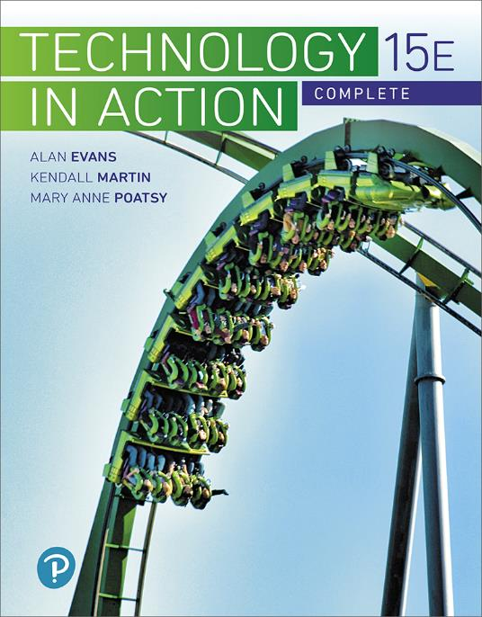
Technology in Action
15th Edition
Chapter 6
Understanding and Assessing Hardware: Evaluating Your System
Notes:
If this PowerPoint presentation contains mathematical equations, you may need to check that your computer has the following installed:
1) MathType Plugin
2) Math Player (free versions available)
3) NVDA Reader (free versions available)

Slide 2
Learning Objectives (1 of 2)
6.1 Describe the changes in CPU performance over the past several decades.
6.2 Compare and contrast a variety of computing devices.
6.3 Describe how a CPU is designed and how it operates.
6.4 Describe tools used to measure and evaluate CPU performance.
6.5 Discuss how RAM is used in a computer system.
6.6 Evaluate whether adding RAM to a system is desirable.
Notes:
Slide 2 is a partial list of textbook Learning Objectives numbers and statements.

Slide 3
Learning Objectives (2 of 2)
6.7 Classify and describe the major types of nonvolatile storage drives.
6.8 Evaluate the amount and type of storage needed for a system.
6.9 Describe the features of video cards.
6.10 Describe the features of sound cards.
6.11 Describe steps you can take to optimize your system’s reliability.
6.12 Discuss how to recycle, donate, or dispose of an older computer.
Notes:
Slide 3 is the final list of textbook Learning Objectives numbers and statements.

Slide 4
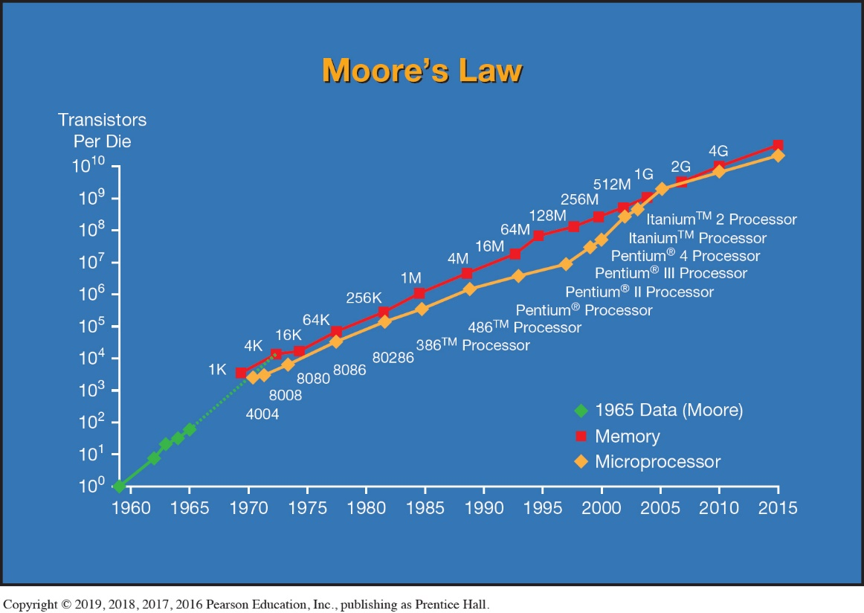
Your Ideal Computing Device Moore’s Law (Objective 6.1)
New technologies emerge quickly
Things to consider
Speed
Moore’s Law
System components
DRAM
Hard drive storage capacity
Notes:
New technologies emerge so quickly, there never seems to be a perfect time to buy.
A rule of thumb, called Moore’s Law, describes the pace at which central processing units improve. This rule predicts that CPU capacity will double about every two years.
In addition to the CPU becoming faster, other system components also continue to improve dramatically. Meanwhile, hard drives have been growing in storage capacity by some 50 percent each year.
Additional notes
System components haven’t changed that much
Basics concepts go back to 1940s
DRAM- Dynamic Random Access Memory

Slide 5
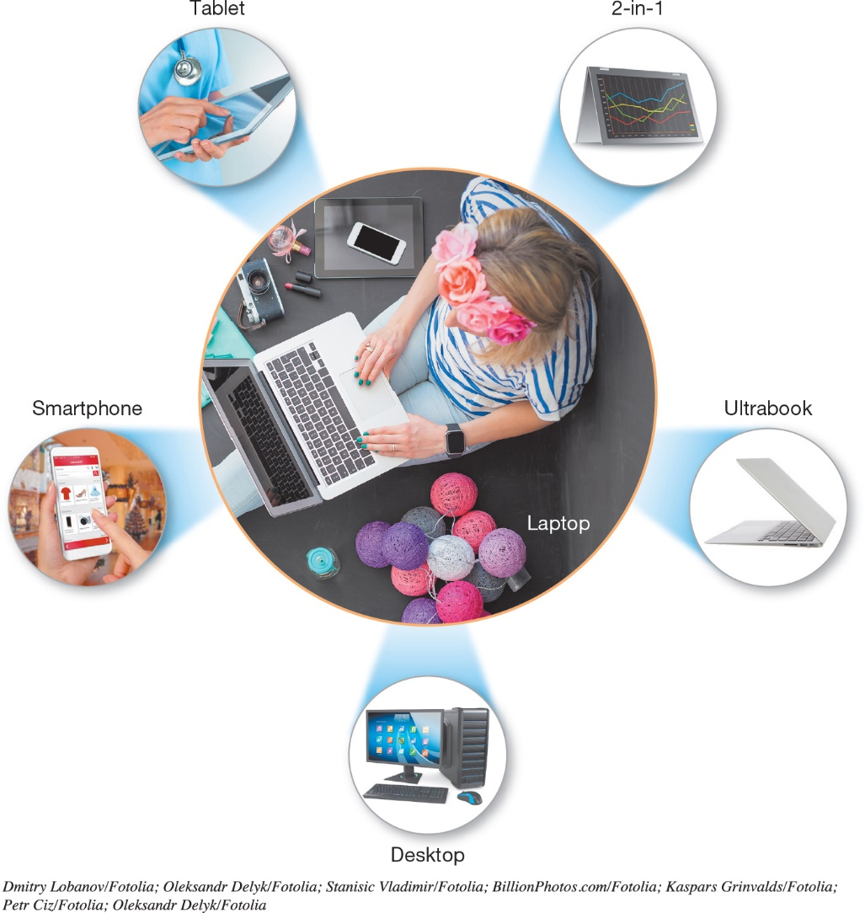
Your Ideal Computing Device Selecting a Computing Device (Objective 6.2)
Huge number of choices
Smartphones
Tablets
Ultrabooks
2-in-1s
Laptops
Desktops
Notes:
How do you know what’s best for you? A huge number of choices are on the market:
Smartphones
Tablets
Ultrabooks
2-in-1s
Laptops
Desktops

Slide 6
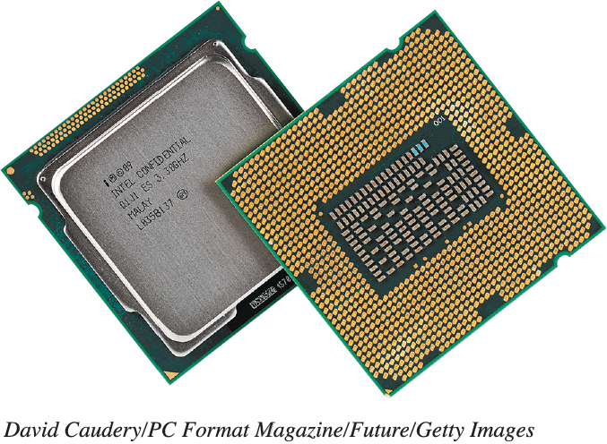
Evaluating the CPU Subsystem How the CPU Works (1 of 3) (Objective 6.3)
Located on motherboard
Processes instructions
Performs calculations
Manages the flow of information
Intel and AMD processors
Notes:
The CPU is located on the system motherboard and is responsible for processing instructions, performing calculations, and managing the flow of information through your computer. The dominant processors on the market are sold by Intel and AMD.
If you have a PC, the System window will show you the type of CPU you have installed.
Additional Notes
Memory to CPU is called “fetch”
CPU decodes changed to what CPU understands
CPU executes what needs to be done
Within CPU there are registers and data is stored there

Slide 7
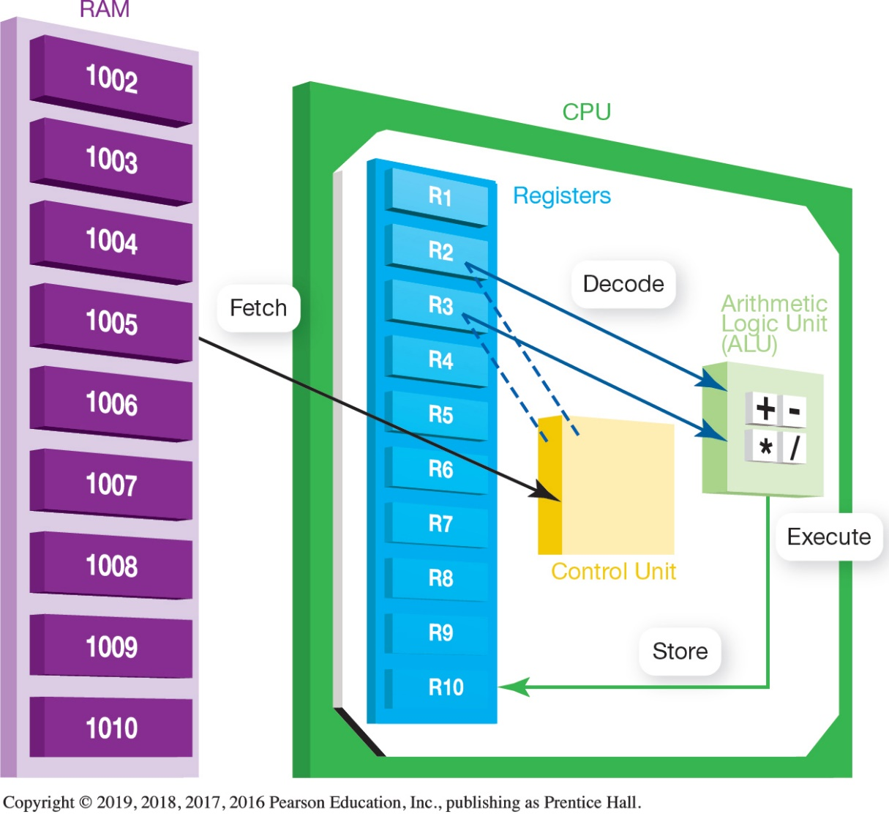
Evaluating the CPU Subsystem How the CPU Works (2 of 3) (Objective 6.3)
Machine cycle
Fetch
Decode
Execute
Store
Two units
Control unit
Arithmetic logic unit (ALU)
Notes:
When the CPU performs a program instruction, it goes through the same steps.
It fetches the required piece of data or instruction from RAM.
It decodes the instruction into something the computer can understand.
It executes the instruction.
It stores the result to RAM before fetching the next instruction.
This process is called a machine cycle.
The CPU is composed of two units: the control unit and the arithmetic logic unit.
Additional Notes
Memory to CPU is called “fetch”
CPU decodes changed to what CPU understands
CPU executes what needs to be done
Within CPU there are registers and data is stored there
Execution is done in ALU then CPU activates where it need to go

Slide 8
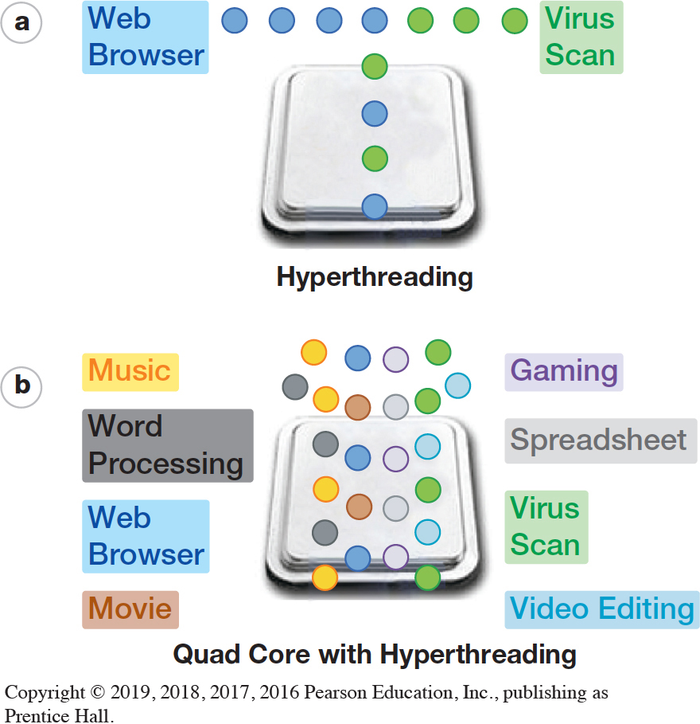
Evaluating the CPU Subsystem How the CPU Works (3 of 3) (Objective 6.3)
CPU’s processing power
Clock speed
Overclocking
Cores
Parallel processing
Cache memory
Pipelining
Hyperthreading
Notes:
A CPU’s processing power is determined by:
Clock speed
Like the heart; every time there is a beat, something is being done
Number of cores
Parallel processing
Amount of cache memory
The clock speed dictates how many instructions the CPU can process each second.
Overclocking means that you run the CPU at a faster speed than the manufacturer recommends.
Speeding up the beat
Overheating -> can stop
Pipelining is a technique that allows the CPU to work on more than one instruction at the same time.
Hyperthreading provides quicker processing of information by enabling a new set of instructions in a different program (or thread) to start executing before the previous set has finished.

Slide 9
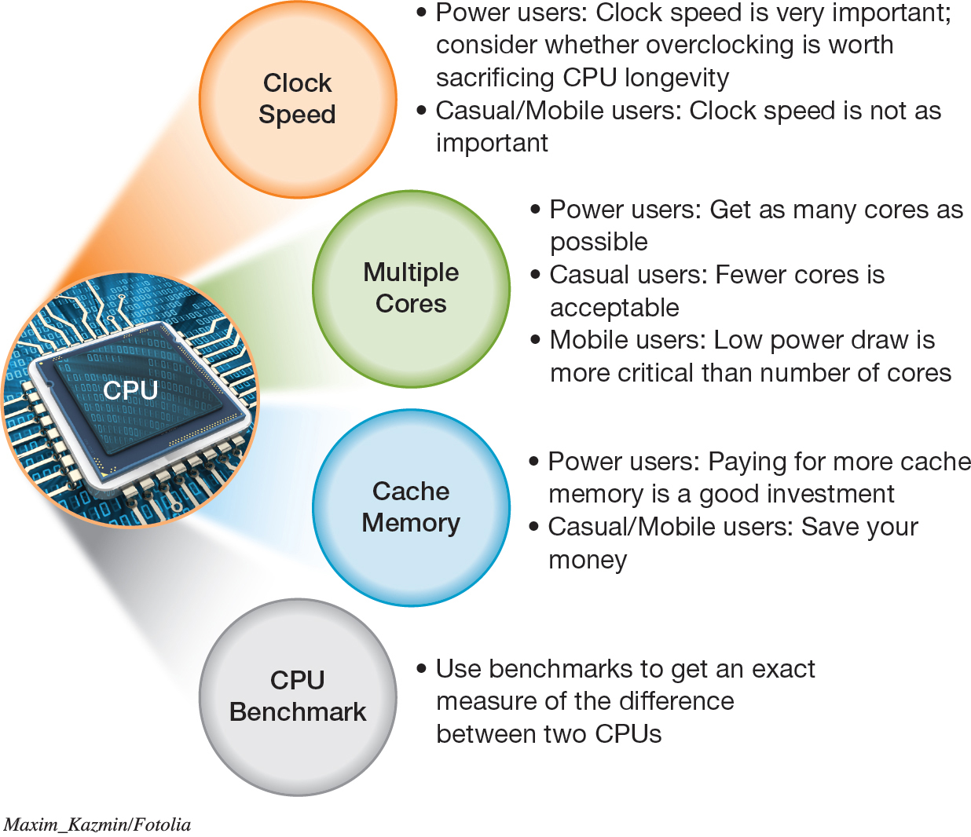
Evaluating the CPU Subsystem Measuring CPU Performance (Objective 6.4)
Notes:
Figure 6.13 lists factors to consider as you decide which specific CPU is right for you.

Slide 10
Evaluating the Memory Subsystem Random Access Memory (1 of 4) (Objective 6.5)
Random Access Memory (RAM)
Short-term memory storage
Volatile storage
Read-only memory (ROM)
Critical startup instructions
Non-volatile storage
Notes:
Random access memory is your computer’s temporary storage space. Although RAM is a form of storage, it really is the computer’s short-term memory.
RAM is an example of volatile storage. When the power is off, the data stored in RAM is cleared out. In addition to RAM, systems always include nonvolatile storage devices for permanent storage of instructions and data. Read-only memory holds critical start-up instructions. Hard drives provide the largest nonvolatile storage capacity.

Slide 11
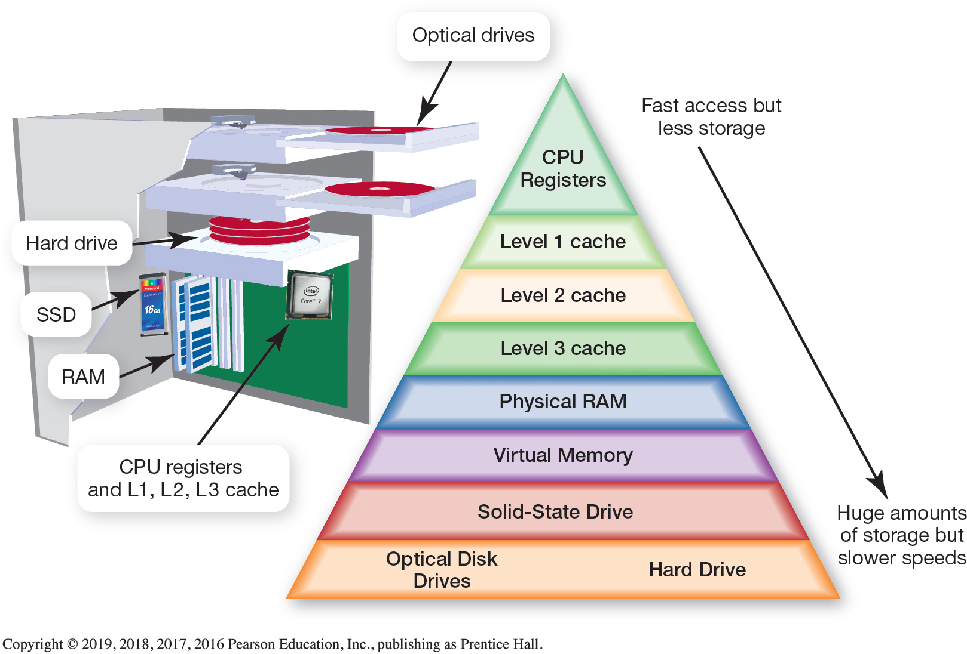
Evaluating the Memory Subsystem Random Access Memory (2 of 4) (Objective 6.5)
Notes:
It’s one million times faster to retrieve data from RAM than from a hard drive. This time is measured in nanoseconds, whereas pulling data from a hard drive takes an average of 10 milliseconds.
The figure shows the types of memory and storage in your system. Each of these has its own tradeoff of speed versus price.
Because the fastest memory is more expensive, systems are designed with much less of it.

Slide 12
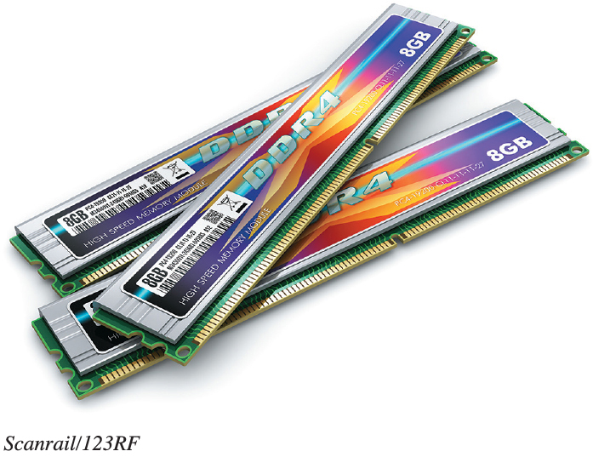
Evaluating the Memory Subsystem Random Access Memory (3 of 4) (Objective 6.5)
Types of RAM
Double data rate 3 (DDR3)
Double data rate 4 (DDR4)
Double data rate 5 (DDR5)
Memory modules
Dual inline memory modules (DIMMs)
Notes:
There are different types of RAM. In most systems, the type of RAM used is double data rate 3 (DDR3) memory modules, which is available in several speeds. The higher the speed, the better the performance. DDR5 memory, which has an even faster data transfer rate, is seen in high-performance video graphics cards.
RAM appears in the system on memory modules, small circuit boards that hold RAM chips and fit into slots on the motherboard.

Slide 13
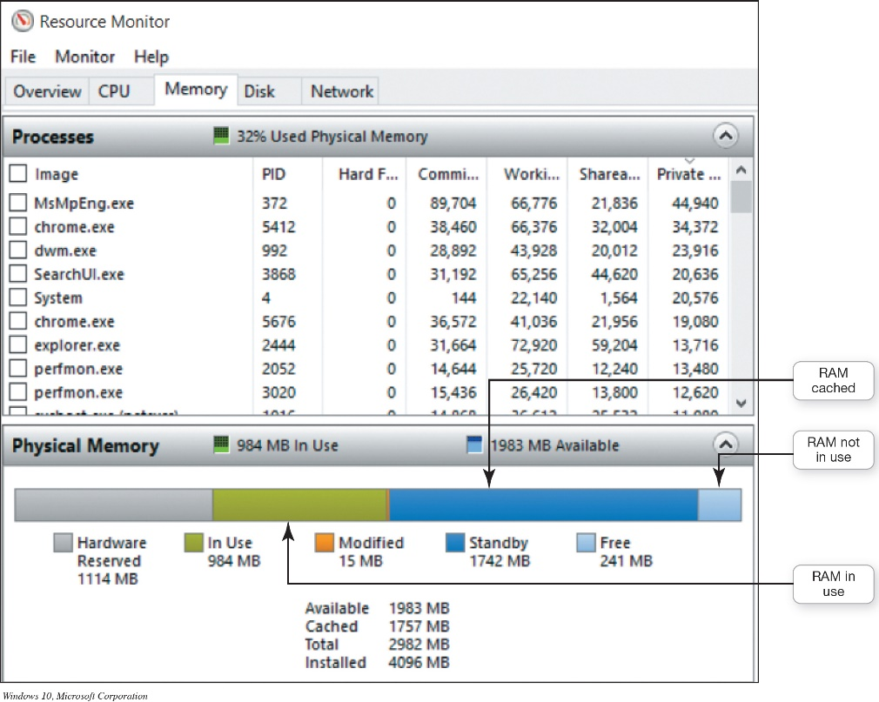
Evaluating the Memory Subsystem Random Access Memory (4 of 4) (Objective 6.5)
SuperFetch
Preloads often used programs into system memory
Resource monitor
Displays how computer resources are being used
Notes:
SuperFetch, a feature of Windows, preloads often used programs into system memory.
The resource monitor shows you how your RAM is being used.

Slide 14
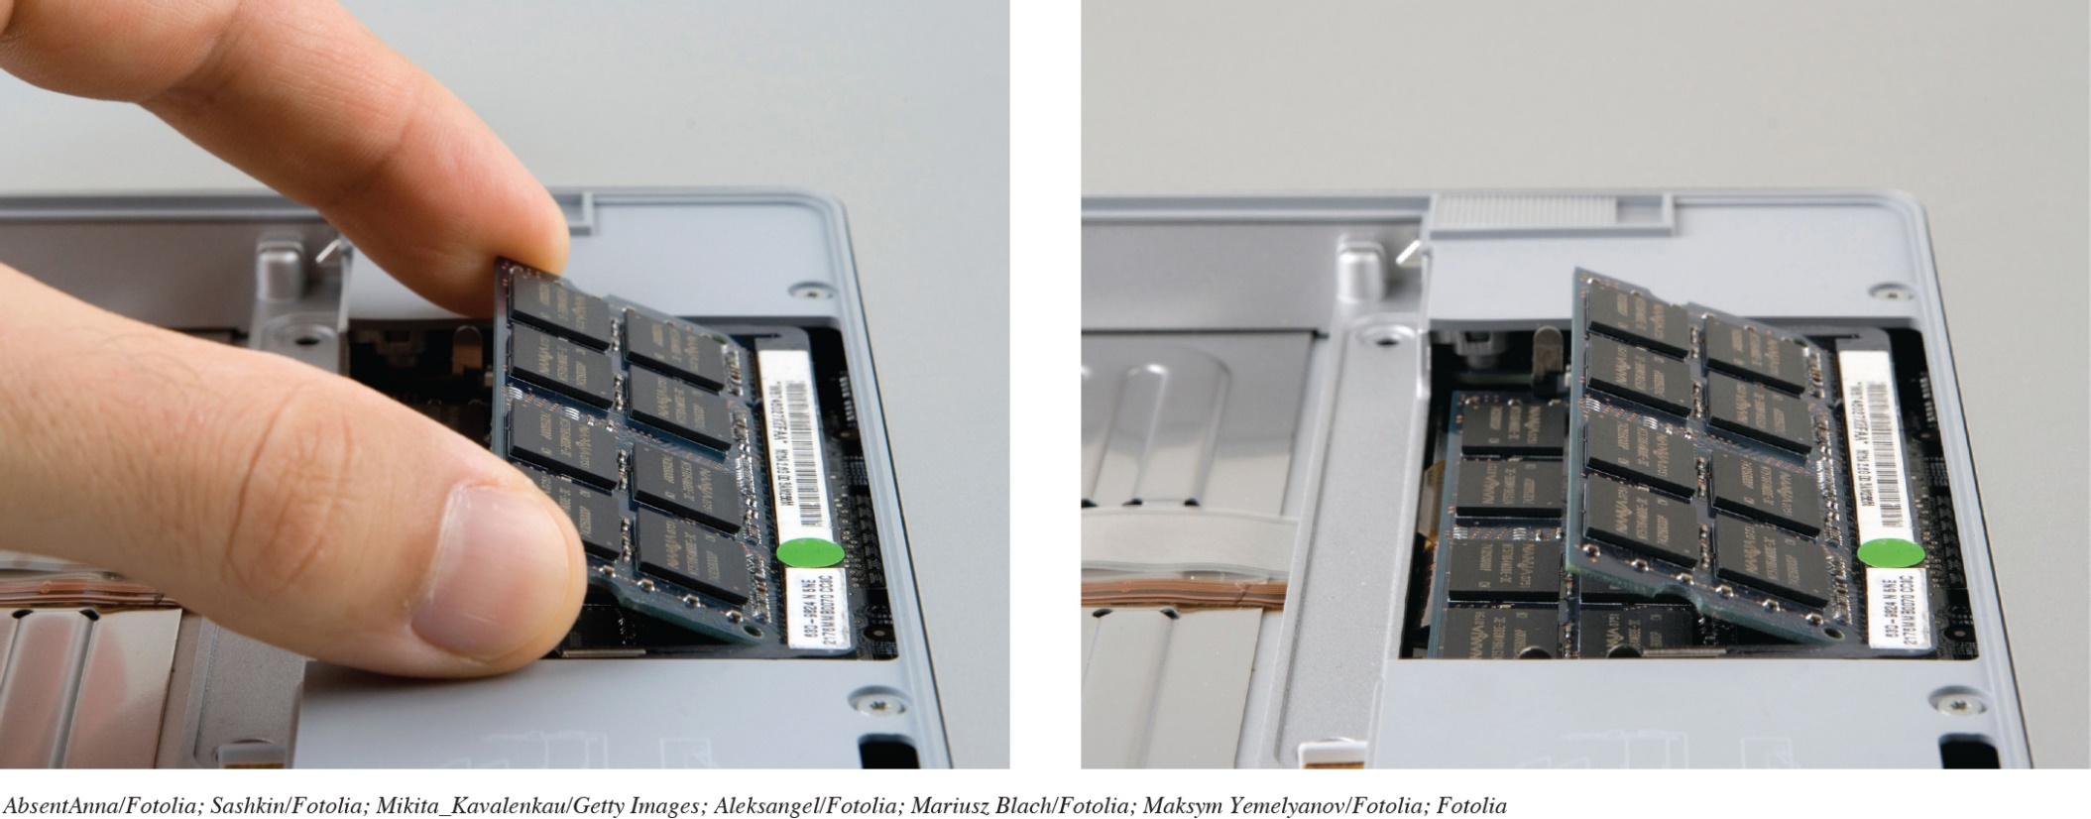
Evaluating the Memory Subsystem Adding RAM (Objective 6.6)
Limited to motherboard’s capacity
Easy to install
Notes:
Adding RAM is limited to the motherboard’s capacity in how many slots are available and the total capacity of each slot.
Adding RAM is fairly easy to install.

Slide 15
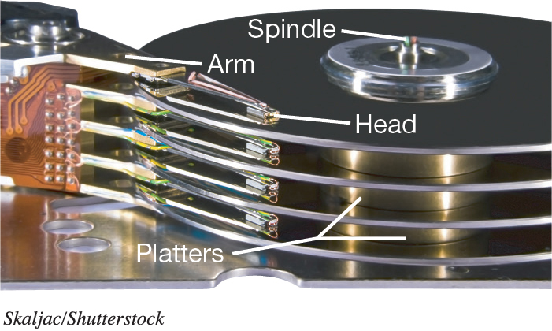
Evaluating the Storage Subsystem Types of Storage Drives (1 of 3) (Objective 6.7)
Mechanical Hard Drives
Coated platters stacked on a spindle
Data saved as pattern of magnetized spots of 1s and 0s
Access time is the time it takes to find the data and make it available
Notes:
A hard drive has several coated, round, thin plates of metal stacked on a spindle. Each plate is called a platter.
When data is saved, a pattern of magnetized spots is created. When the spots are aligned in one direction, they represent a 1; when aligned in the other direction, they represent a 0.
These are the smallest pieces of data that computers can understand. Your computer translates these patterns of magnetized spots into data.
Access time is the amount of time it takes the drive to find the data and make it available for processing.

Slide 16
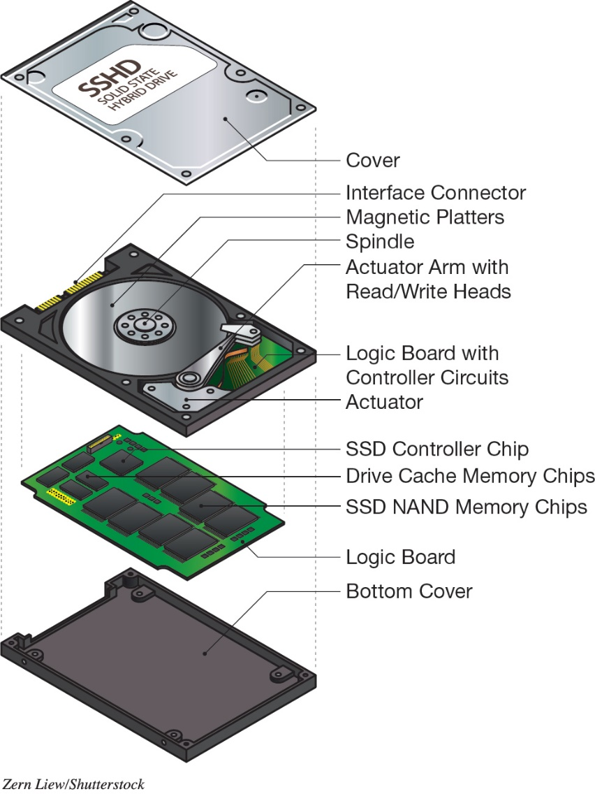
Evaluating the Storage Subsystem Types of Storage Drives (2 of 3) (Objective 6.7)
Solid State Drives
Fast access times
Generate little heat
Run with no noise
Require little power
Solid State Hybrid Drives
Notes:
A solid-state drive (SSD) uses electronic memory and has no mechanical motors or moving parts. Having no mechanical motors allows SSDs to offer incredibly fast access times.
In addition, SSDs run with no noise, generate very little heat, and require very little power, making them a popular option in ultrabooks.
The SSHD drive is a single unit that contains both a SSD and a mechanical hard drive.

Slide 17
Evaluating the Storage Subsystem Types of Storage Drives (3 of 3) (Objective 6.7)
Optical Drives
Tiny pits burned into the disc by a high-speed laser
Types of Drives
Compact disc (CD)
Digital video disc (DVD)
Blu-ray disc (BD)
Notes:
Optical drives are disc drives that use a laser to store and read data. Data is saved to a compact disc, digital video disc, or Blu-ray disc called optical media.
Optical discs store data as tiny pits that are burned into the disc by a high-speed laser. Data is read from a disc by a laser beam, with the pits and nonpits translating into 1s and 0s.

Slide 18
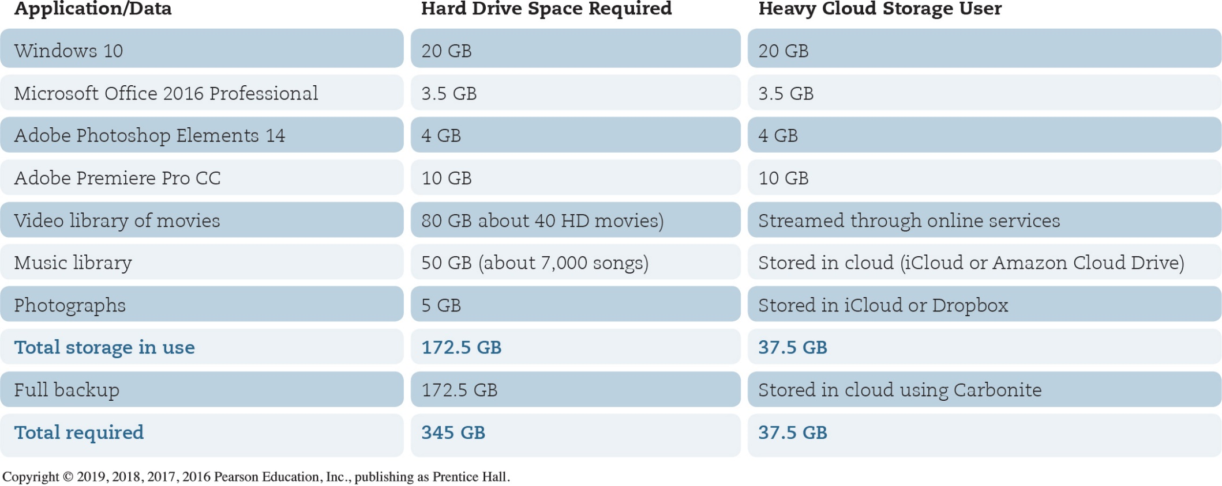
Evaluating the Storage Subsystem Storage Needs (1 of 3) (Objective 6.8)
Notes:
Figure 6.24 shows an example of storage calculation.

Slide 19
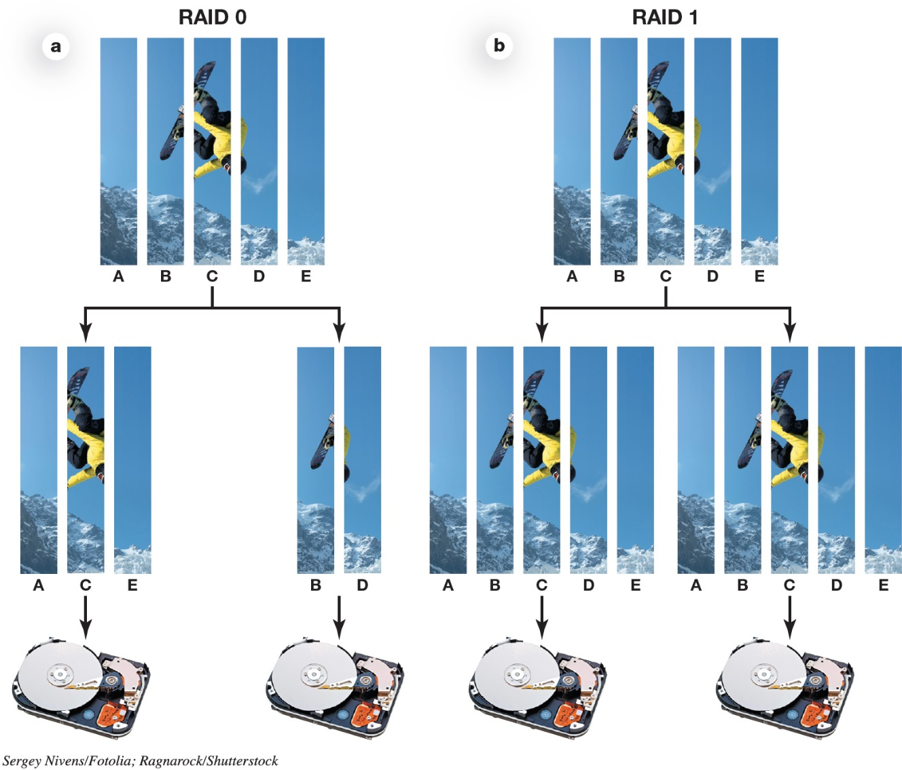
Evaluating the Storage Subsystem Storage Needs (2 of 3) (Objective 6.8)
Redundant array of independent disks (RAID)
RAID 0
RAID 1
Notes:
A redundant array of independent disks (RAID) is a set of strategies for using more than one drive in a system (see Figure 6.25).
RAID 0 and RAID 1 are the most popular options for consumer machines.

Slide 20
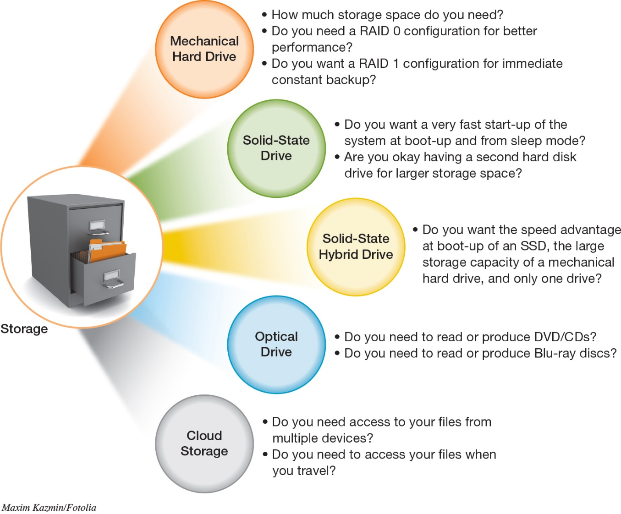
Evaluating the Storage Subsystem Storage Needs (3 of 3) (Objective 6.8)
Notes:
Figure 6.26 summarizes the factors you should consider in evaluating your storage subsystem.

Slide 21
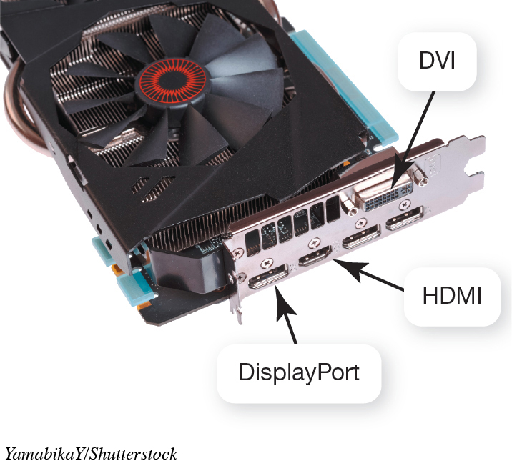
Evaluating the Media Subsystems Video Cards (1 of 2) (Objective 6.9)
Video display depends on two components
Video card
Monitor
Ports
HDMI
DVI
DisplayPort adapter
Notes:
The way video is displayed depends on two components: your video card and your monitor.
Modern video cards let you connect video equipment using a number of different ports:
HDMI ports for high-definition TVs, Blu-ray players, or gaming consoles
DVI ports for digital LCD monitors
DisplayPort adapters, a newer style of port that can connect to digital monitors or projectors

Slide 22
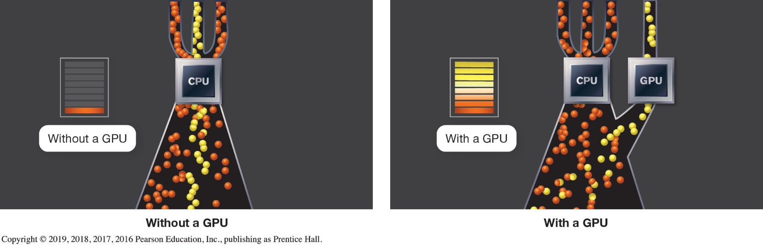
Evaluating the Media Subsystems Video Cards (2 of 2) (Objective 6.9)
Video memory
Screen Resolution dialog box
Found in Advanced Settings (Windows)
Graphics Processing Unit (GPU)
Notes:
Video systems include their own RAM, called video memory.
Information about your system’s video card is found in the Advanced Settings of the Screen Resolution dialog box.
Displaying graphics demands a lot of computational work from the CPU. Video cards come with their own graphics processing unit (GPU).
The figure shows that the CPU can run much more efficiently when a GPU does all of the graphics computation.

Slide 23
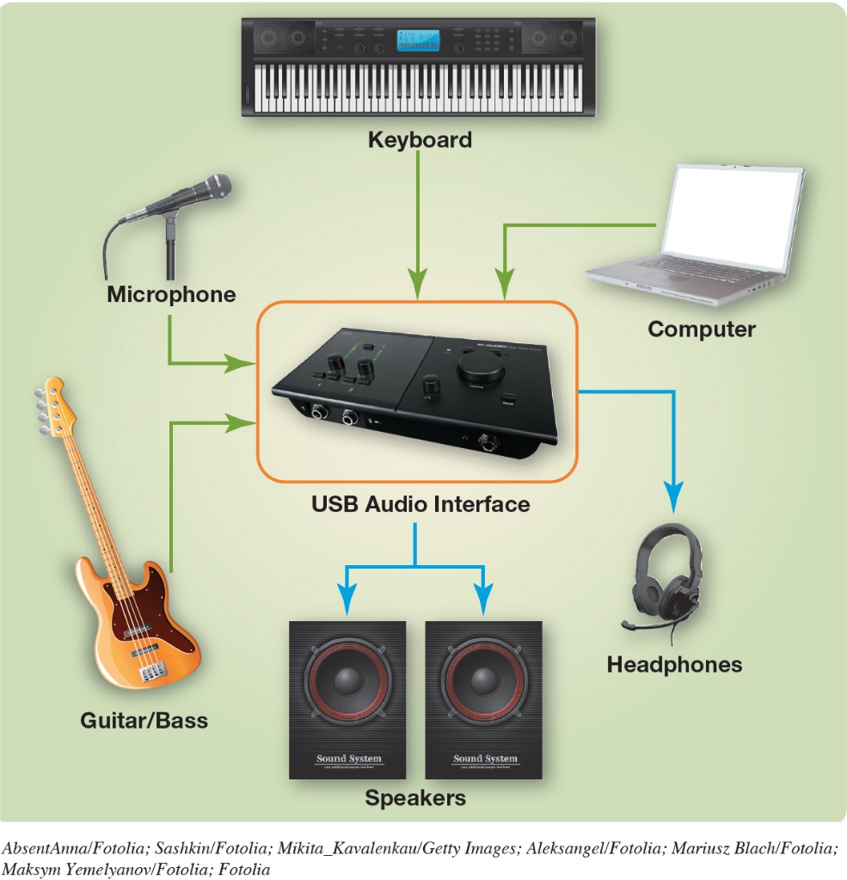
Evaluating the Media Subsystems Sound Cards (Objective 6.10)
Speakers and a sound card
3-D sound technology
Surround sound
Dolby Digital 7.1
MIDI interface
Notes:
If you play games, music, and video, you might want to upgrade your speakers or sound card.
3-D sound technology is better at convincing the human ear that sound is omnidirectional.
Surround sound makes the listener experience sound as if it were coming from all directions.
Dolby Digital 7.1 takes digital sound and reproduces it in eight channels—seven for the listening field, and the eighth for low-frequency sound, which is sent to a subwoofer.
MIDI is an electronics standard that allows different kinds of electronic instruments to communicate with each other and with computers.

Slide 24
Evaluating System Reliability and Moving on Maintaining System Reliability (1 of 2) (Objective 6.11)
Reliability
Antivirus program
Spyware and adware
Clear out unnecessary files
Run Disk Defragmenter
Automate key utilities
Notes:
There are several important issues to consider to increase your system’s reliability:
Install an antivirus program
Install a spyware and adware program
Clear out unnecessary files
Run Disk Defragmenter
Automate key utilities

Slide 25
Evaluating System Reliability and Moving on Maintaining System Reliability (2 of 2) (Objective 6.11)
System crashes
Try System Restore
Consider Windows Refresh
Check amount of RAM
Investigate any error codes
Search with Google
Notes:
If your system crashes you might:
Try System Restore
Consider Windows Refresh
Check amount of RAM
Investigate any error codes
Search with Google

Slide 26
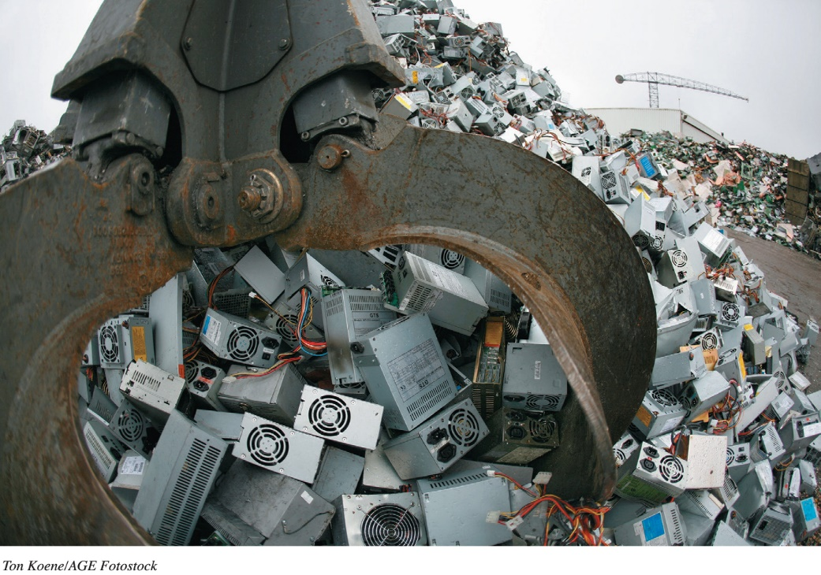
Evaluating System Reliability and Moving on Getting Rid of Your Old Computer (Objective 6.12)
Benefits of maintaining two systems
Environmental impact
Mercury
Cadmium
Donate
Remove all data before donating
Notes:
Before you get rid of your computer, be sure to consider what benefit you might obtain by having two systems.
Before throwing away a system, it is important to consider the environmental impact. Mercury in LCD screens and cadmium in batteries and circuit boards are all toxic.
An old system could be donated to a nonprofit organization.
Before donating or recycling a computer, make sure you carefully remove all data from your hard drive.

Slide 27
Questions
?

Slide 28

Copyright
All rights reserved. No part of this publication may be reproduced, stored in a retrieval system, or transmitted, in any form or by any means, electronic, mechanical, photocopying, recording, or otherwise, without the prior written permission of the publisher. Printed in the United States of America.

